Slide 1
Accessible content creation
Learn to Enable Digital for Everyone
www.LearnToEnable.co.uk

Slide 2
This GAAD session will cover
What is inclusive digital content and why it is important?
An overview of some simple concepts to learn and apply

Slide 3
Let’s start with a quick question…
What digital content have you created this week?
Documents
Presentations
Email
Social media posts
Video content
Any other?
How often do you create it?
What content will you create in the workplace?

Slide 4
What do you know?
What is meant by the term digital accessibility?
Whose responsibility is it to make content inclusive?
How difficult is it to make content accessible?
Handout for notes

Slide 5
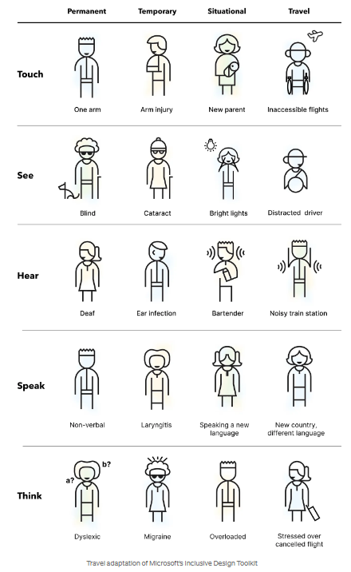
All of us can make a difference
All of us can make content accessible
There are some very basic principles that everyone can learn and apply
The basics can make a big difference
Solve for one, extend to many from the Microsoft Inclusive Design Toolkit
Permanent, temporary and situational

Slide 6
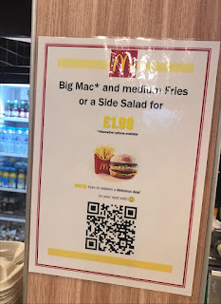
Examples to discuss…
Note who is impacted by these barriers?
Alt text
Alt handout 1, Alt handout 2
The use of colour
Colour alone handout 1, Colour alone handout 2
Colour contrast
Colour contrast handout
Headings, links and alt text
HLA handout 1, HLA handout 2
Some of these examples have two handouts to compare

Slide 7
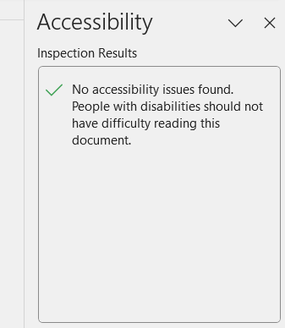
Workshop - some tips to learn
Take part in a mini workshop to make content accessible
The accessibility checker Microsoft Word (YouTube)
Colour contrast
Headings (YouTube)
Links
Alt text (YouTube)
For this workshop you will be given a template document.

Slide 8
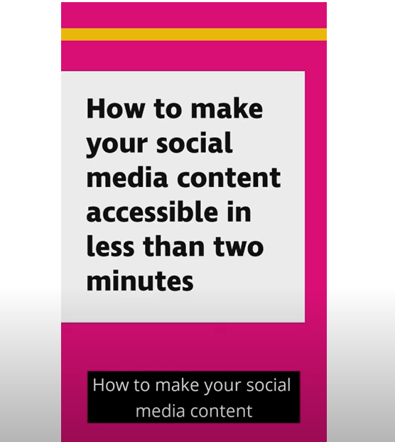
Simple concepts to take away…
Watch the 2-minute RNIB Social Media Video
Simple social media tips to takeaway:
CamelCase hashtags
Appropriate use of emojis
Captions on videos
Alt text examples

Slide 9
Share what you have learned
Why not post on social media to spread the word
Don’t forget make your social media content accessible:
Keep the message clear
Use CamelCase Hashtags
Alt text if you use images (or images of text)
Limit your emojis and use them at the end of sentences
Videos need captions
For information about 12 accessibility principles and more information visit: www.LearnToEnable.co.uk #LearnToEnable #GAAD

