Slide 1
Accessible content creation for learner variability
Learn to Enable Digital for Everyone
www.LearnToEnable.co.uk

Slide 2
This session will cover
Discussing examples of content to support more user-friendly teaching materials
A demonstration and mini workshop of some simple concepts to learn and apply

Slide 3
Let’s start with a quick question…
What digital content have you created this week and how often?
Documents
Presentations
Posters
Emails
Social media posts
Video content
VLE/Intranet

Slide 4
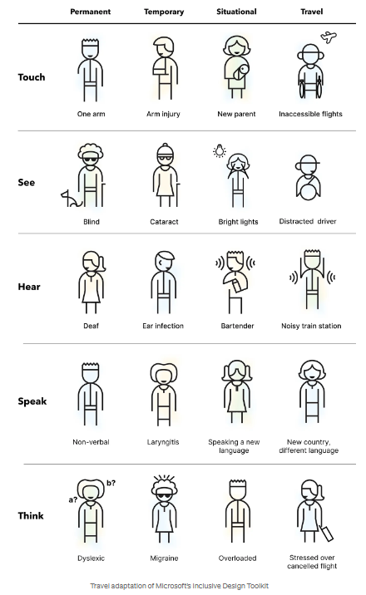
Helping you to help others
All of us can make content accessible
There are some very basic everyday principles that everyone can learn and apply
Solve for one, extend to many from the Microsoft Inclusive Design Toolkit (Permanent, temporary and situational)
Think of it as skills for good practice and formatting that makes content user friendly everyone

Slide 5
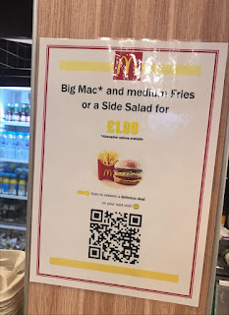
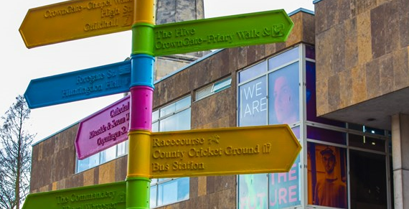
Examples to discuss…
Digital content examples:
Captions
Alt text
The use of colour
Colour contrast
Headings and links
Text formatting
Explore examples and discuss the challenges.

Slide 6
Workshop - some tips to learn
Workshop templates: www.learntoenable.co.uk/sgs
Word document checker and demonstration
PowerPoint infographic checker and demonstration

Slide 7
Why awareness is important: The accessibility checkers don’t cover everything - PowerPoint:
It covers | It does not cover
Titles | Descriptive hyperlinks
Alt text on images | Use of fonts or capitals
Alt text on shapes | Colour contrast of text and background
Reading order | The amount of content on slides or clear language
Items that are grouped | Grouped items, text in shapes for exporting to PDF
Tables – merged and split cells | Images of text

Slide 8
The Word accessibility checker also does not cover everything:
It covers | It does not cover
Colour contrast | Descriptive hyperlinks
Alt text on images | Use of fonts, alignment or capitals
Items not inline | Clear language
Note: Headings are in a different part of the checker | Headings are in navigation pane
Tables – merged and split cells | Grouped items (PDF implications) Text boxes (PDF implications)
Reading order | Images of text

Slide 9
Any questions…

